Slide 1


TypeScript In-Depth:
Intro

Slide 2
Course Overview
Intro
Types Basics
Functions
Interfaces
Classes
Modules
Generics
Decorators
Asynchronous Patterns

Slide 3

History
2012
Anders Hejlsberg
Microsoft
Open Source
Flexibility and Performance

Slide 4
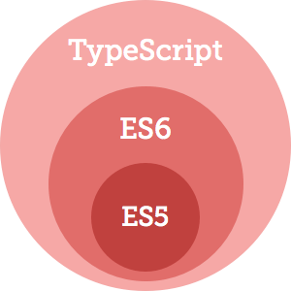
TypeScript

Slide 5

How It Works
TypeScript – language with static typization and compilation to JavaScript
We can set JavaScript version in TypeScript configuration
TypeScript supports compilation to the following JavaScript versions:
ES6
ES5
ES3

Slide 6

TypeScript Compiler
first.ts
first.js
var x: number;
class HelloWorld {}
var x;
function HelloWorld {}

Slide 7
TypeScript → JavaScript
TypeScript
JavaScript
class Greeter {
greeting: string;
constructor (message: string) {
this.greeting = message;
}
greet() {
return “Hello, ” + this.greeting;
}
}
var Greeter = (function() {
function Greeter(message) {
this.greeting = message;
}
Greeter.prototype.greet = function() {
return “Hello, ” + this.greeting;
};
return Greeter;
})();
Encapsulation
Static Typing

Slide 8
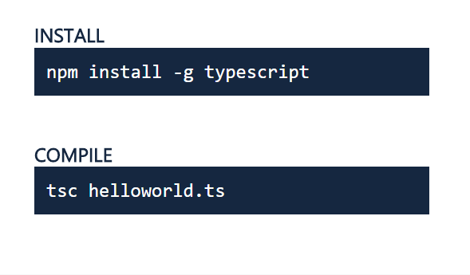
Get TypeScript

Slide 9
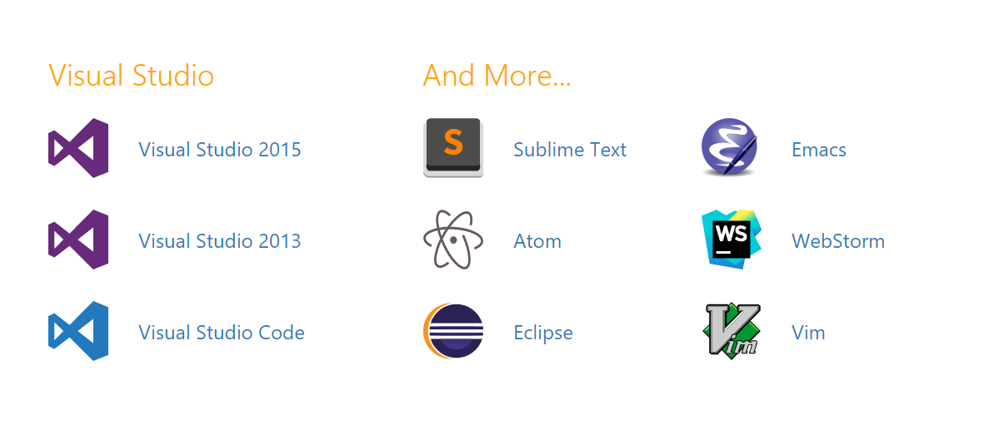
IDE with TypeScript Support

Slide 10
What is TSLint?

Slide 11

What is TSLint?
Conceptually similar to popular JavaScript linters
JSLint
ESLint
Installed with npm
Rules stored in tslint.json file
Executed from a command line
TSLint extension available for Visual Studio Code
Plugins are available for other editors

Slide 12
How to install, configure and use TSLint

Slide 13
TSLint Install
Website:
https://palantir.github.io/tslint/
Global installation
$ npm install tslint –g
Configuration
tslint --init
Use it
tslint [options] [file…]
gulp-tslint

Slide 14
Extension for Visual Studio Code

Slide 15
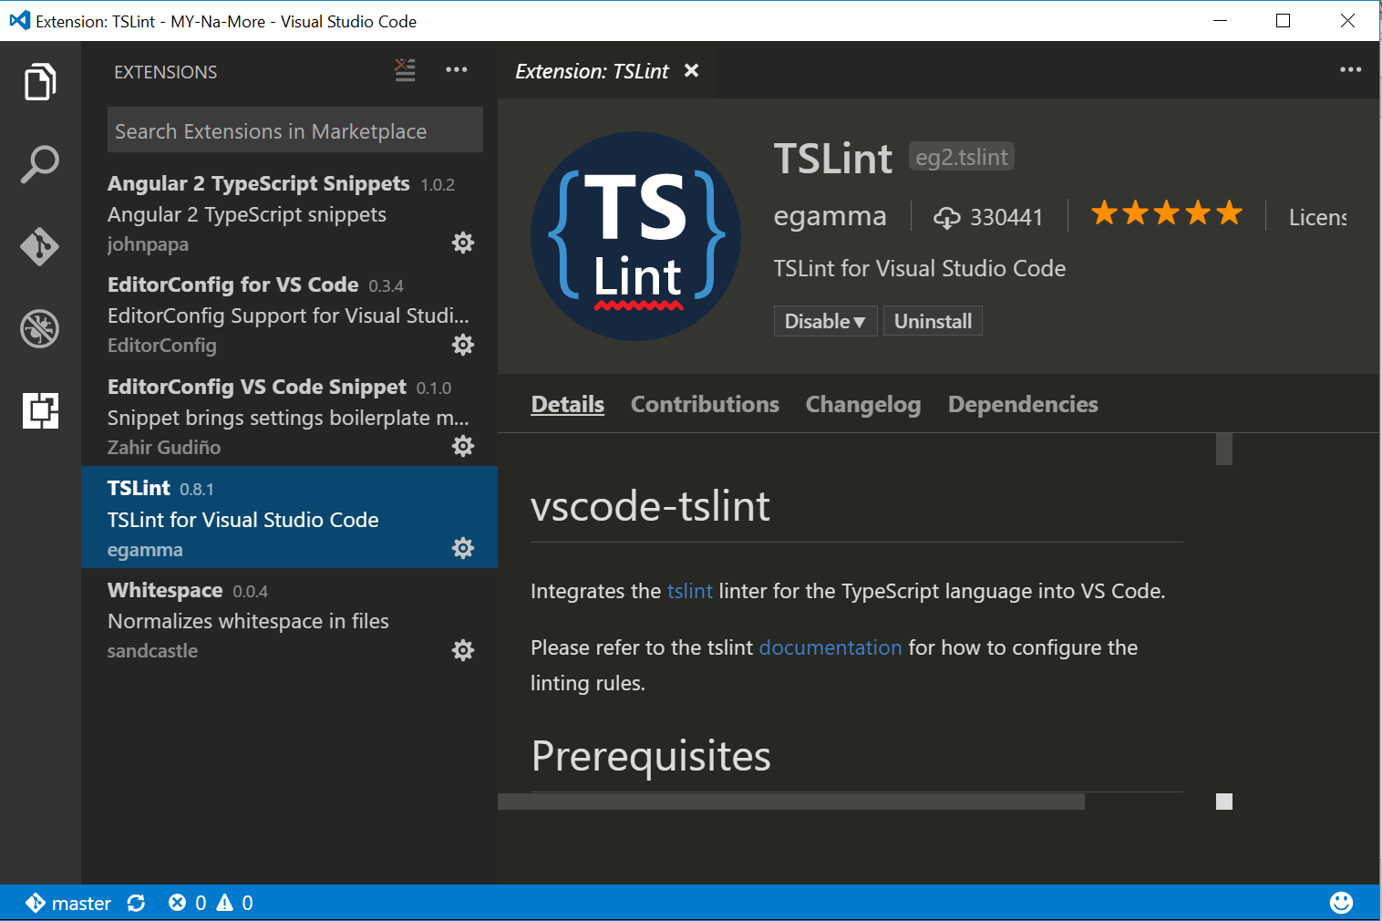
Extension for Visual Studio Code

